Slide 1
HYPERLEDGER
Checking Account
Team 1
Siddhant Chauhan, Sammy Chien, Feichi Hu, Matthew Ruffner, Mao Wang, Majid Jalili
Notes:
1. intro and use cases(slides 1 - 5) **Maohua**
2. Features (slide 6)**Sidd**
3. Network (slides 7-8) *Matthew*
4. Implementation (slides 9-11)**feichi**
5. first half of demo (slides 12 - 17) Majid: Matthew we can swap, if you do not feel comfortable. If so ping me
6. second half of demo (slides 18 - 29 (end)) **Sammy**

Slide 2
USE CASE
01
02
AGENDA
03
SMART CONTRACT DETAILS
NETWORK MEMBERS & PERMISSION DETAILS
04
DEMO
EXECUTION

Slide 3
01
USE CASES

Slide 4
CHECKING ACCOUNTS on Blockchain
People want to use crypto address as a checking account
USDC/USDT: stable coins directly pegged against U.S. dollar - no worries for volatile market fluctuation!
Many typical checking account features are missing for wallet on common public chains
Privacy - the entire transaction history is saved forever on public chain!
We only want to reveal part of our financial information
Sometimes only balance needed
Sometimes only 3-month transaction history needed
Notes:
The ERC-20 token smart contract demonstrates how to create and transfer fungible tokens using an account-based model. In an ERC-20 account-based model, there is an account for each participant that holds a balance of tokens. A mint transaction creates tokens in an account, while a transfer transaction debits the caller's account and credits another account.
In this sample it is assumed that only one organization (played by Org1) is in a central banker role and can mint new tokens into their account, while any organization can transfer tokens from their account to a recipient's account. Accounts could be defined at the organization level or client identity level. In this sample accounts are defined at the client identity level, where every authorized client with an enrollment certificate from their organization implicitly has an account ID that matches their client ID. The client ID is simply a base64-encoded concatenation of the issuer and subject from the client identity's enrollment certificate. The client ID can therefore be considered the account ID that is used as the payment address of a recipient.
In this tutorial, you will mint and transfer tokens as follows:
A member of Org1 uses the Mint function to create new tokens into their account. The Mint smart contract function reads the certificate information of the client identity that submitted the transaction using the GetClientIdentity.GetID() API and credits the account associated with the client ID with the requested number of tokens.
The same minter client will then use the Transfer function to transfer the requested number of tokens to the recipient's account. It is assumed that the recipient has provided their account ID to the transfer caller out of band. The recipient can then transfer tokens to other registered users in the same fashion.

Slide 5
Advantage of Private Chain Wallet
Only authorized organizations can run the node! It's centralized but it's also distributed within the hyperledger!
Better Know-Your-Customer compliance! (a major roadblock to global crypto wallet adoption)
Customers can selectively choose to disclose their information
Customers can retract their authorization after it’s no longer needed
Notes:
The ERC-20 token smart contract demonstrates how to create and transfer fungible tokens using an account-based model. In an ERC-20 account-based model, there is an account for each participant that holds a balance of tokens. A mint transaction creates tokens in an account, while a transfer transaction debits the caller's account and credits another account.
In this sample it is assumed that only one organization (played by Org1) is in a central banker role and can mint new tokens into their account, while any organization can transfer tokens from their account to a recipient's account. Accounts could be defined at the organization level or client identity level. In this sample accounts are defined at the client identity level, where every authorized client with an enrollment certificate from their organization implicitly has an account ID that matches their client ID. The client ID is simply a base64-encoded concatenation of the issuer and subject from the client identity's enrollment certificate. The client ID can therefore be considered the account ID that is used as the payment address of a recipient.
In this tutorial, you will mint and transfer tokens as follows:
A member of Org1 uses the Mint function to create new tokens into their account. The Mint smart contract function reads the certificate information of the client identity that submitted the transaction using the GetClientIdentity.GetID() API and credits the account associated with the client ID with the requested number of tokens.
The same minter client will then use the Transfer function to transfer the requested number of tokens to the recipient's account. It is assumed that the recipient has provided their account ID to the transfer caller out of band. The recipient can then transfer tokens to other registered users in the same fashion.

Slide 6
Our Features
Customer can create account
Customer can deposit $$ (USDT, USDC or any legit stable coins) into their checking account
Customer can withdraw their digital currency
Customer can transfer between their families, friends and business partners!
Customer can authorize a third party to check for their balance.
Customers can authorize a third party to check for account transactions of past ‘N’ months. The ‘N’ can be specified by customer! (to be implemented, but it's very straightforward to do so!)
Notes:
We wanted to add some features that are going to be present in our project.
We wanted to give ability for customers to create their own accounts and within those accounts the customers can deposit currency. This can be in the form of USDT, USDC or any other legit stable coins. Stablecoins are cryptos who have their market value pegged to some external reference for example the US Dollar. Once the $$ is deposited into their checking account then customers can withdraw digital money or currency using their accounts.
Some of the other features include allowing the ability to easily transfer between parties for example friends, families and other business partners.
The customers can also authorise a 3rd party to check balance for example when applying for a travel visa. Another straightforward feature to be implemented is if a 3rd party needs access to past transaction for some time. This could be for N number of months and the N can be specified by the customer so only that data is shared or given access to.
Now I am going to move on to our network and permission details for our project and pass it on to Matt

Slide 7
02
NETWORK MEMBERS & PERMISSION DETAILS

Slide 8


NETWORK & PERMISSION DETAILS
Initial User Introduction:
Only approved users and organizations can use the checking account blockchain
Users can be added by an existing and verified organization.
Organizations running the hyperledger verify credibility of the user and take responsibility for their user actions
Permission Granting Process:
User gives the third party ID (e.g. customs or border control) to the organization running hyperledger
The hyperledger will add that ID into the permitted list of each user
Each user has a separate permitted list and the organization can only see the users’ balance if the user grants access
Notes:
As hyperledger fabric is a permissioned ledger, we implemented our own membership identity service wherein new users are added by those who have already been registered and verified. So, once our application has enrolled the admin user/organization from then on users who are already part of the network add new ones while the admin user verifies the credibility of said new user. This puts responsibility into the hands of the users/organizations that added the new user as well as the admin organization.
I will now pass it on to Feichi to discuss how we implemented this hyperledger

Slide 9
03
SMART CONTRACT DETAILS

Slide 10
Chaincode Implementation Details
Chaincode written in Javascript
Application and test code written in Javascript

Slide 11
SMART CONTRACT DETAILS
Implemented Functions
Functions available for user use
Retrieve all accounts
Create account
Check account existence
Retrieve account with accountId
Retrieve your own account without knowing your accountId
Deposit money
Withdraw money
Transfer money to another account
Get your own account balance
Authorize a third party account to check your own account balance
Check another account for their account balance (must be authorized by that account)
Create account
Retrieve your own account
Deposit money
Withdraw money
Transfer money to another account
Get your own account balance
Authorize a third party account to check your own account balance
Check another account for their account balance (must be authorized by that account)

Slide 12
04
EXECUTION / DEMO

Slide 13
EXECUTION
Account creation
Deposit money into account
Withdraw money from account
Transfer money to another account
Account balance checking by third party
Code: https://github.com/sammychien/hyperledger-checking-account/tree/main/fabric-samples/checking-account

Slide 14
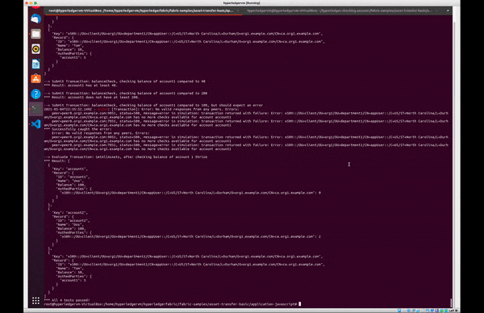
EXECUTION
Brief video showing app execution:

Slide 15
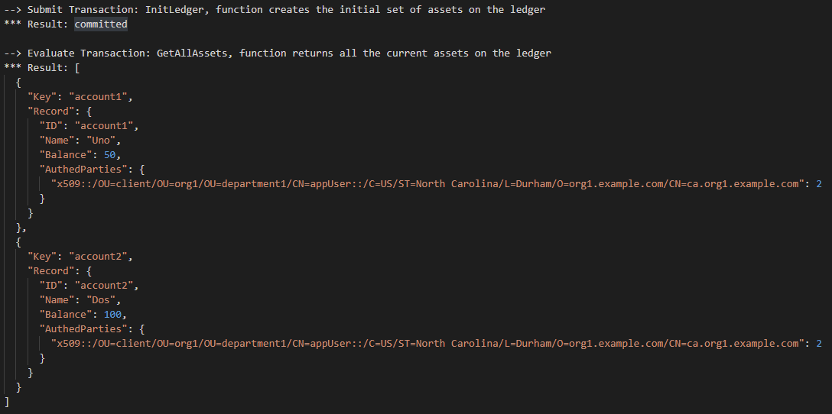
LIVE DEMO
Part 1: Creating an Account
Start out with only the initial database data

Slide 16
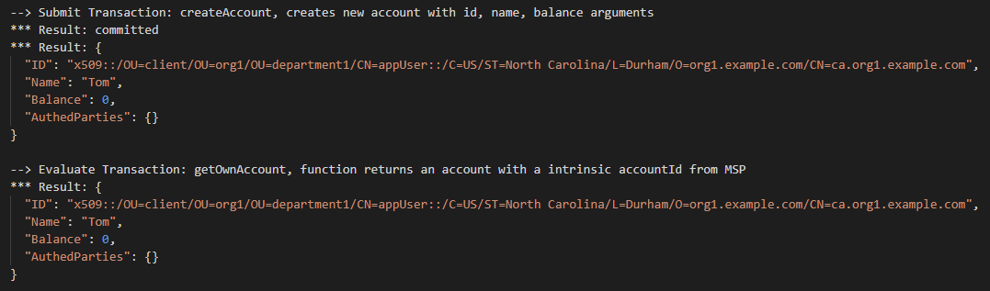
LIVE DEMO
Part 1: Creating an Account
Create the account for ‘Tom’ and see the created account

Slide 17
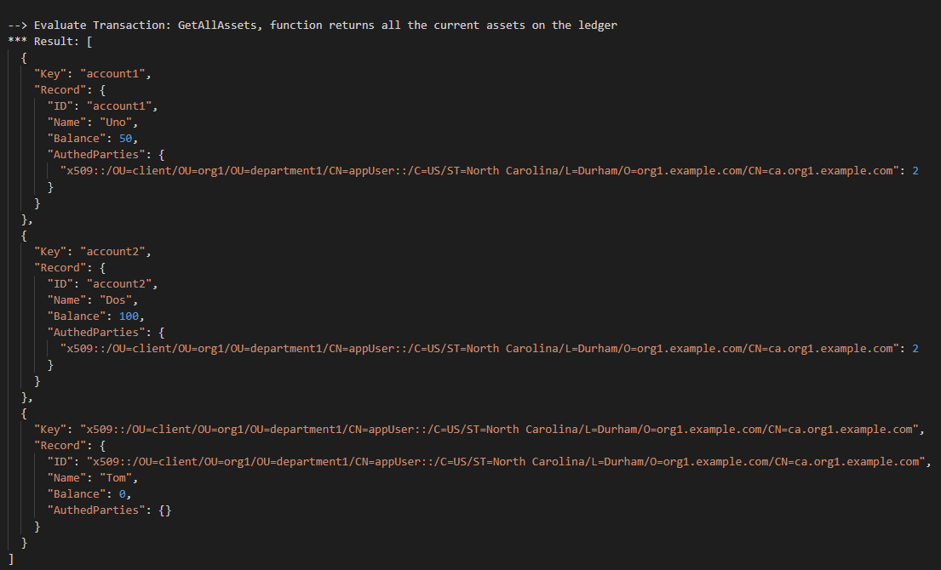
LIVE DEMO
Part 1: Creating an Account
Current DB state includes created account

Slide 18
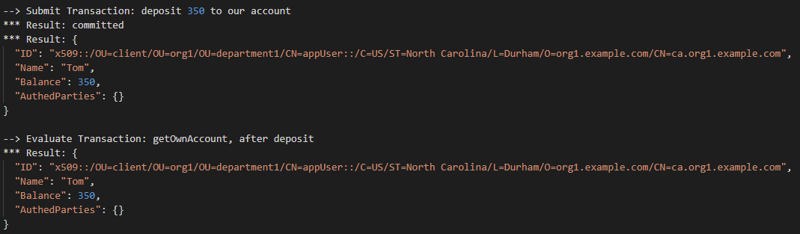
LIVE DEMO
Part 2: Depositing Money into Account
Deposit 350 credits into Tom’s account

Slide 19
LIVE DEMO
Part 3: Withdrawing Money from Account
Attempt to withdraw 450 credits
(larger than account balance)
Results in an Error being thrown

Slide 20
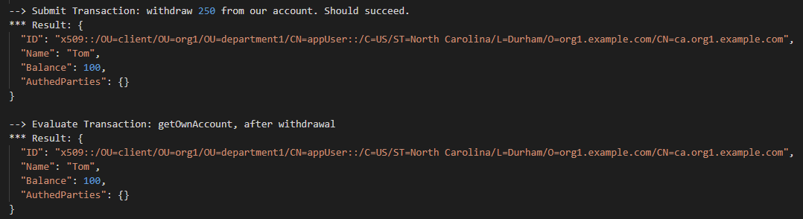
LIVE DEMO
Part 3: Withdrawing Money from Account
Attempt to withdraw 250 credits
(smaller than account balance)
Success

Slide 21
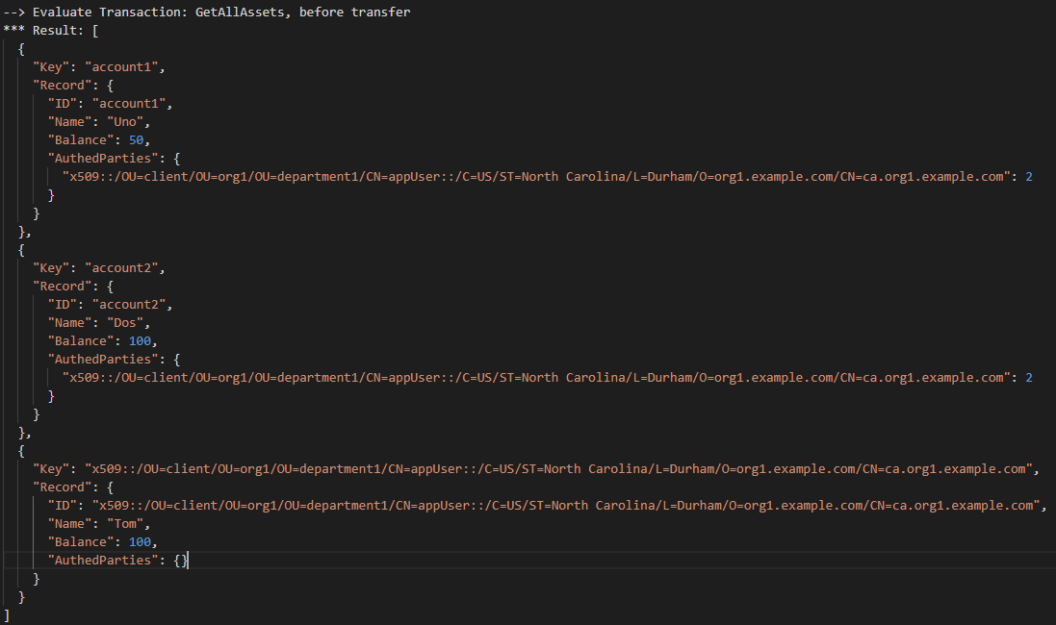
LIVE DEMO
Part 4: Transfer money to another account
Check DB state
account1: 50
account2: 100
Tom: 100

Slide 22
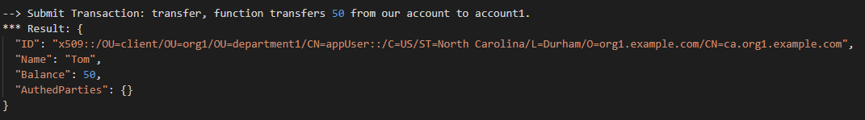
LIVE DEMO
Part 4: Transfer money to another account
Transfer 50 credits to ‘account1’ from Tom’s account

Slide 23
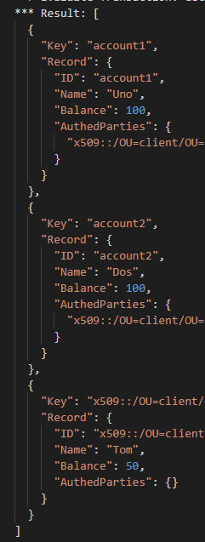
LIVE DEMO
Part 4: Transfer money to another account
Check DB state
account1: 100
account2: 100
Tom: 50

Slide 24
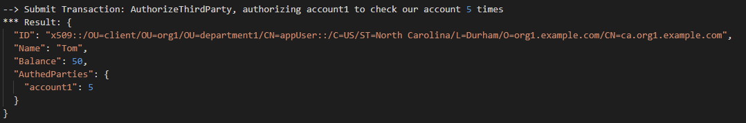
LIVE DEMO
Part 5: Account balance checking by third party
Authorize account1 to check Tom’s account 5 times

Slide 25
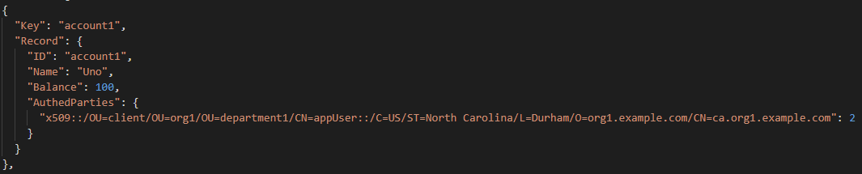
LIVE DEMO
Part 5: Account balance checking by third party
account1 already allows Tom’s account to check its balance twice
Tom’s account is the only account that can check account1’s balance

Slide 26
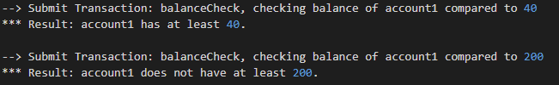
LIVE DEMO
Part 5: Account balance checking by third party
Tom’s account now checks account1’s balance twice:
Check for balance of at least 40 credits
Check for balance of at least 200 credits

Slide 27
LIVE DEMO
Part 5: Account balance checking by third party
Tom’s account was not able to check account1’s balance a third time
Checking the balance again throws an error

Slide 28
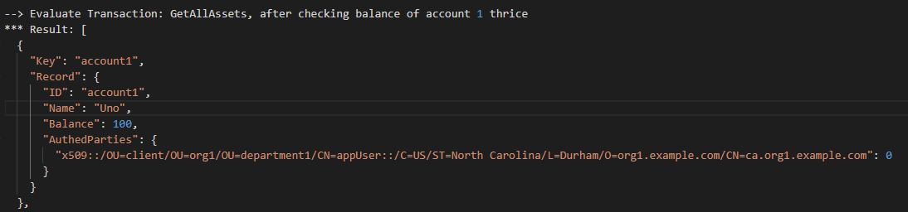
LIVE DEMO
Part 5: Account balance checking by third party
Check the DB state:
Tom’s account can check account1’s balance zero more times

Slide 29
THANKS
OPEN FOR QUESTIONS

